Slide 1

Direction Sense

Slide 2
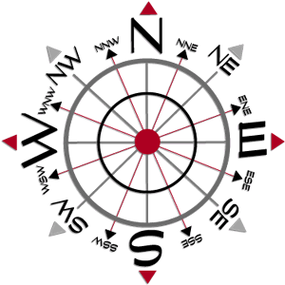
Direction Sense

Slide 3
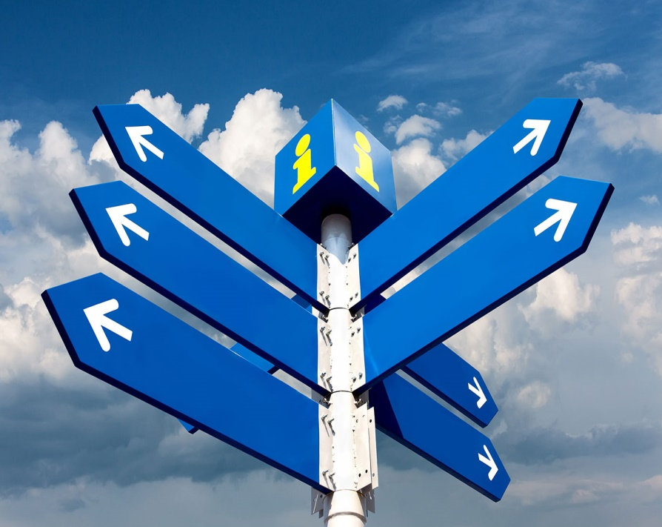
Direction sense is one of the prime topics in logical reasoning.
Questions from this topic generally involve an individual travelling certain distances in certain directions.
The best way to solve these problems is to represent the traces of the path traversed by the person, as found in the information provided by the question.

Slide 4
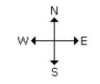

There are four main directions –
North, South, East and West.
There are four cardinal directions – North-East(N-E), North-West(N-W), South-East
(S-E), South-West(S-W).

Slide 5
Things to be noted:
At the time of sunrise if a man stands facing the east, his shadow will be towards west.
At the time of sunset the shadow of an object is always in the east.
If a man stands facing the North, at the time of sunrise his shadow will be towards his left and at the time of sunset it will be towards his right.
At 12.00 noon, the rays of the sun are vertically downward hence there will be no shadow.
Always rainbow will occur opposite to the sun.
Always shortest distance should be calculated.

Slide 6
Practice Questions
Santosh goes first 7 Km north then turns left and move 10 Km, again he turns left and moves 7 Km, how far is he from the starting point?
[A] 7 Km
[B] 10 Km
[C] 17 Km
[D] 24 Km

Slide 7
Mohan travels 7 Km to north direction from where he is standing and turns to his right. He then walks straight for another 3 Km. Turning to his right he moves 7 Km. How many Km away from starting point is he?
[A] 1
[B] 2
[C] 3
[D] 5

Slide 8
A man walks 5 Km towards south and then turns to the right. After walking 3 Km he turns to the left and walks 5 Km. Now in which direction is he from the starting place?
[A] West
[B] South
[C] North east
[D] South west

Slide 9
4. Ranuka started walking from her house, she first walked for 3 Km towards west, then she turned towards north and moved 4 Km in that direction. How far is Ranuka from her house?
[A] 3 Km South
[B] 3 Km South-East
[C] 5 Km West
[D] 5 Km North-West

Slide 10
5. Ashiq walks southwards, then takes a half right turn and then a left turn. In which direction is he walking now?
[A] South-East
[B] South-West
[C] South
[D] North

Slide 11
A man walks northwards. After a while he turns to his right and a little further to his left. Finally, after walking a distance of 1km, he turns towards his left again. In which direction is he moving now?
[A] South
[B] North
[C] West
[D] East

Slide 12
A man started walking positioning his back towards the sun. After sometime, he turned left, then turned right and then towards the left again. In which direction is he going now?
[A] North or South
[B] East or West
[C] North or West
[D] South or West

Slide 13
A man went 10 Km towards south. Then turned East and covered 10 Km and turned to the right. Again after 10 Km he turned to the left and covered 10kms to reach the destination. How far and in which direction is he to his starting point?
[A] 20√2 km, South- East
[B] 20√2 km, North- East
[C] 20√2 m, South- East
[D] 20 km, South East

Slide 14
A man went 15 Km to the North. Then he turned West and covered 10 Km. Then he turned south and covered 5 Km. Finally, turned to East, he covered 10 Km. In which direction is he from his house?
[A] West
[B] East
[C] North
[D] South

Slide 15
If South-East becomes North, North-East becomes West and so on. What will West become?
[A] North East
[B] North West
[C] South East
[D] South West

Slide 16
Rahul put his timepiece on the table in such a way that at 6 PM hour hand points to north. In which direction the minute hand will point at 9:15 PM?
[A] South East
[B] South
[C] North
[D] West

Slide 17
K is 40m South-West of L. If M is 40m South-East of L, then M is in which direction of K?
[A] East
[B] West
[C] North-East
[D] South

Slide 18
Shadow Type Questions:
Shadow of any object is always opposite of SUN, if it is the case of Morning then Shadow will fall in the WEST and if it is the case of Evening then shadow will fall in the EAST.

Slide 19
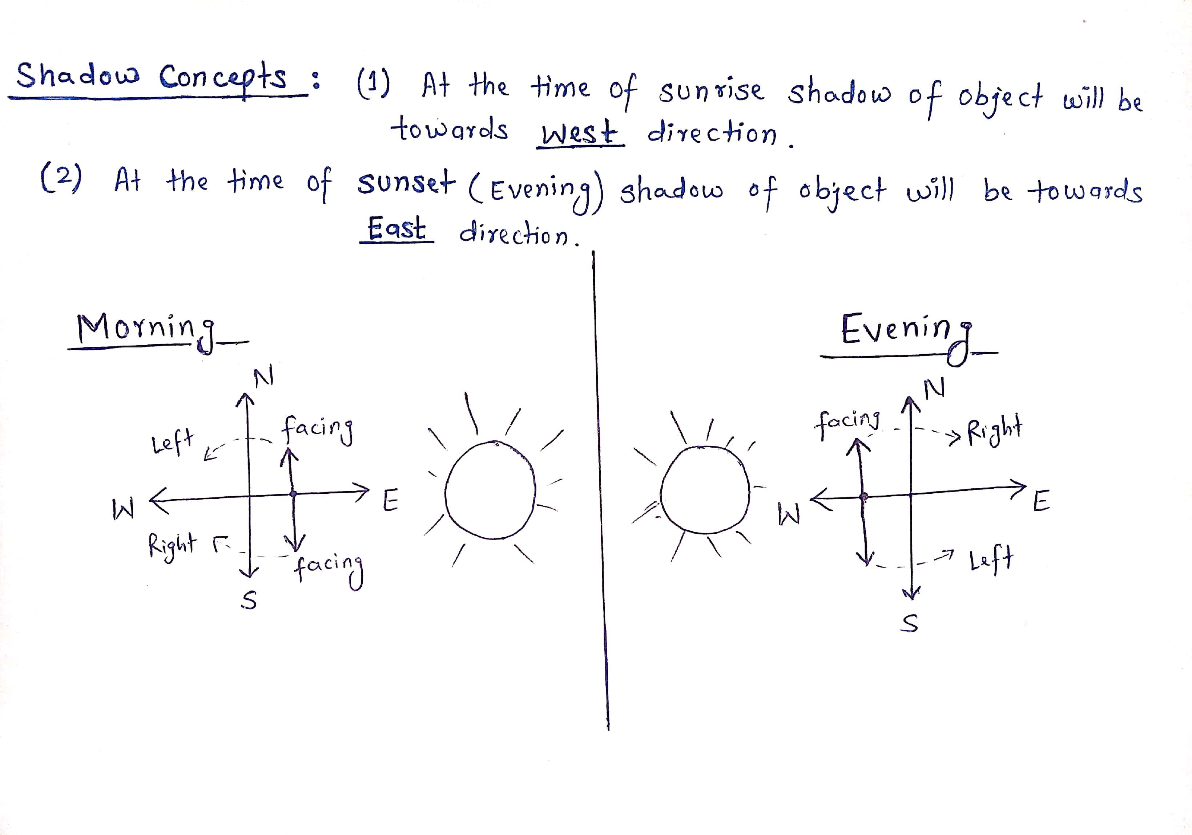

Slide 20
If a man stands facing North in the Morning his shadow will be towards his left and if he is facing North in Evening his shadow will be towards his Right.
If a man stands facing South in the Morning his shadow will be towards his Right and if he is facing South in Evening his Shadow will be towards his Left.

Slide 21
One evening before sunset Rekha and Hema were talking to each other face to face. If Hema’s shadow was exactly to the right of Hema, which direction was Rekha facing?
[A] North
[B] South
[C] East
[D] West

Slide 22
One morning Udai and Vishal were talking to each other face to face at a crossing. If Vishal’s shadow was exactly to the left of Udai, which direction was Udai facing?
[A] East
[B] West
[C] North
[D] South

Slide 23
Roshan walks 10 meters westwards, then turns left and walks 10 meters. He then again turns left and walks 10 meters. He takes a 45 degree turn to his right and walks straight. In which direction is he walking now?
[A] South-East
[B] South
[C] South West
[D] East

Slide 24
After his office hours in the evening, Gautam starts walking facing the sun. First he turns to his right, then he turns to his left and after walking for some meters to his left, he turns to his right. In what direction is he moving now?
[A] South
[B] North
[C] West
[D] East

Slide 25
Amit’s office is situated 5 kilometers North of Ben’s office. Ben starts from his office and walks 2 kilometers towards Amit’s office. He then turns right and walks 3 kilometers and then turns left and walks 3 kilometers. To which direction will he turn to reach Amit’s office?
[A] West
[B] North
[C] South
[D] East

Slide 26
A lady leaves her home and walks 30 meters in North-West direction and then 30 meters in South-West. Next, she walks 30 meters in South-East direction. Finally, she turns towards her house. In which direction is she moving now?
[A] North-East
[B] North-West
[C] South-East
[D] South-West

Slide 27
Deepak walks 8 kilometers East, turns South-West and walks another 8 kilometers. He again takes a turn towards North-West and walks another 8 kilometers. In which direction from his starting point is he standing now?
[A] North-East
[B] South
[C] West
[D] East

Slide 28
The school is to the West of the hospital. The hospital is to the South of the police post. The workshop is to the North of the school. If the 4 places are equidistant from each other, then to which direction of workshop is the police post?
[A] East
[B] West
[C] North
[D] South

Slide 29
Directions for Q21 to Q25:
Joe walks 2 kilometers towards North and turns to his right and walks 4 kilometers more. He then turns to his right and walks 4 kilometers and turns again to his right and walks another 4 kilometers. Here he meets Renu who is coming from the opposite direction. They both stop there.
After taking the first turn, in which direction was Joe going?
[A] South
[B] North
[C] West
[D] East

Slide 30
If the starting point is marked ‘A’ and finishing point is marked ‘B’. What will be the distance between these points?
[A] 10 Km
[B] 8 Km
[C] 6 Km
[D] 2 Km
From which direction was Renu coming?
[A] West
[B] North
[C] East
[D] South-East

Slide 31
After taking the second turn, in which direction was Joe walking?
[A] South
[B] West
[C] North
[D] East
If Joe is to again reach the point from where he started, in which direction will he have to go from where he’s standing now?
[A] East
[B] North
[C] North-East
[D] South-East

Slide 32
A clock is so placed that at 12 noon its minute hand points towards North-East. In which direction does its hour hand point at 1.30 pm?
[A] North
[B] South
[C] East
[D] West
One evening before sunset, two friends Jane and Jackie were talking facing each other. If Jackie's shadow was exactly to his right side, which direction was Jane facing?
[A] North
[B] South
[C] East
[D] West

Slide 33


